Slide 1
LAYOUT GROUND FLOOR

Slide 2
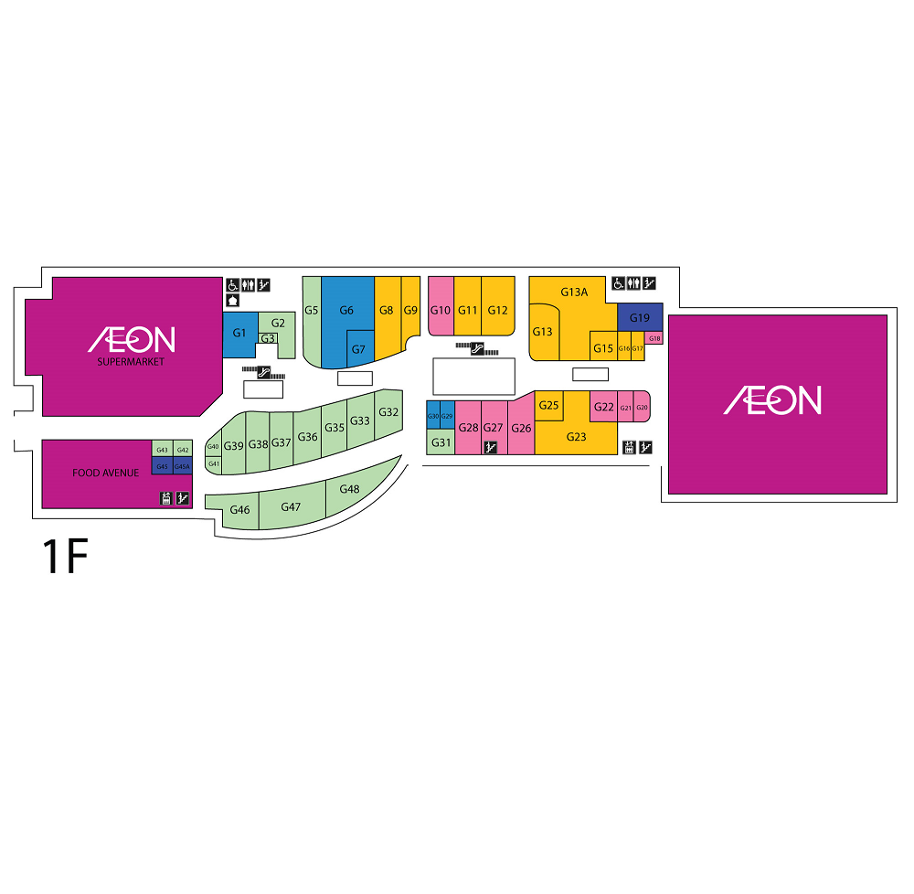
Layout Ground Floor

